Slide 1
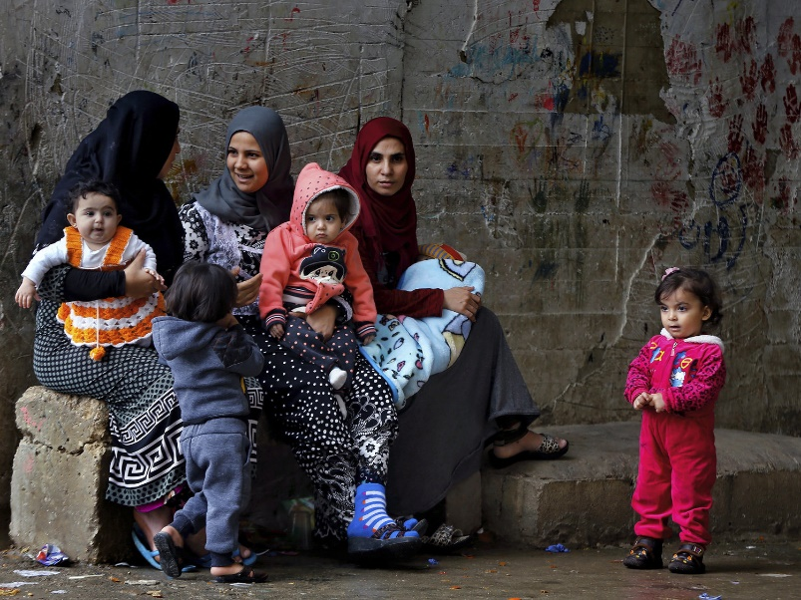
Reproductive Health in Refugee Women
Heike Thiel de Bocanegra, PhD, MPH
Associate Professor Department of Obstetrics and Gynecology, University of California, Irvine
SPH 295 International Health,
University of California, Davis

Slide 2
Objectives
Identify statistics of refugee arrivals to the US
Compare Canadian and US refugee screening guidelines for contraceptive use
List impact of refugee status on maternal morbidity
Describe the Refugee Reproductive Health Network (ReproNet)

Slide 3
Poll questions
The US does not receive any refugees at this moment.
In 2018, Canada received more refugees than the U.S
10% of refugees to the US arrive in California
More than half of refugees to the US arrive in ten states.
The counties with the largest percentages of refugees in California are:
San Diego, Los Angeles, San Francisco
San Diego, Los Angeles, Sacramento
San Diego, Los Angeles, San Jose

Slide 4
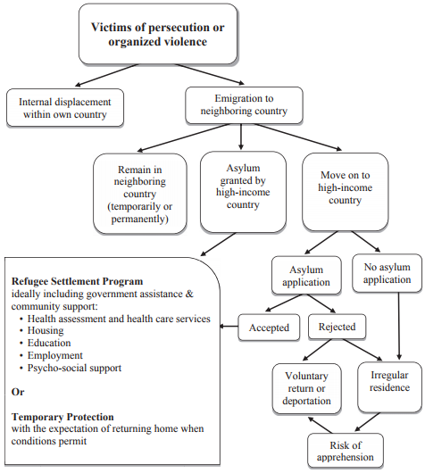
Pathways to Safety for Victims of Persecution or Organized Violence
Notes:
Good morning, it is a pleasure to be here and talk to you about health and health care for refugees who arrive in high resource countries. Only 16% of all refugees resettled by the UNHCR are resettled in countries such has EU, Canada, USA and Australia; In this table I show the various pathways of survivors of persecution or organized violence to high resource countries. So on the very left you see internally displaced who have to leave their home but stay within their national borders. However, in addition to refugees who are screened by the UNHCR and foreign embassies and then resettled in the high resource countries, there is also a considerable number of asylum applicants who entered the country with another status and request asylum once they are in the country and may get the asylum granted (and then become a legal resident) or not (then you stay undocumented or return to your country). And all those differences impact the type of support that an individual receives.
Specific date of entry
Standardized health exam at entry to US
Support from resettlement agencies to integrate, including “cultural orientation” and Medicaid enrollment assistance (90 days)
Eligible for Medicaid for at least eight months
Accelerated path to citizenship

Slide 5
Assistance to refugees after arrival
Specific date of entry
Standardized health exam at entry to US
Support from resettlement agencies to integrate, including “cultural orientation” and Medicaid enrollment assistance (90 days)
Eligible for Medicaid for at least eight months
Assistance for asylum seekers varies by state

Slide 6
U.S. Refugee Admissions
US Refugee Processing Center
https://www.wrapsnet.org/documents/Graph%20Refugee%20Admissions%20FY2020_03_31.pdf

Slide 7
The New York Times
Sept 17, 2018
Trump to Cap Refugees Allowed
Into U.S. at 30,000, a Record Low
Syrian refugees preparing to leave Beirut, Lebanon, this month to return to their homes in Syria. Photo Credit: Anwar Amro/Agence France-Presse — Getty Images

Slide 8
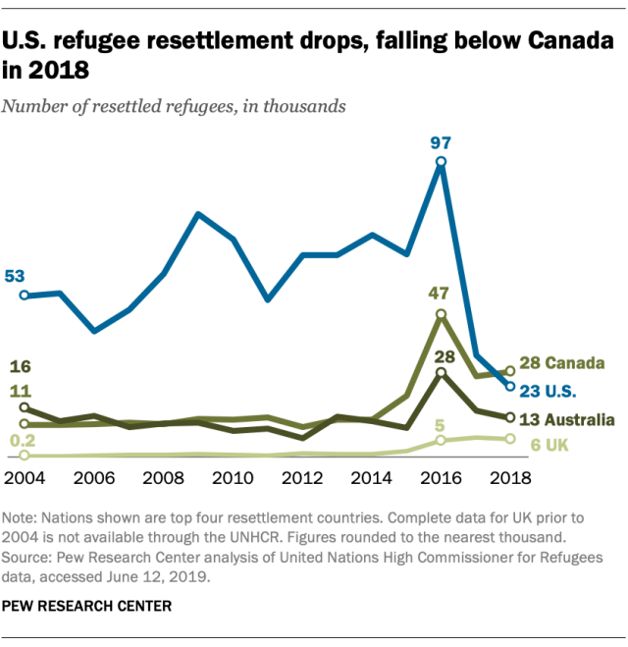

Slide 9
US Refugees by state, 2019
https://www.pewresearch.org/fact-tank/2019/10/07/key-facts-about-refugees-to-the-u-s/ft_19-10-07_refugees_top-states-us-refugee-resettlement-fiscal-2019/; https://www.migrationpolicy.org/article/refugees-and-asylees-united-states
Notes:
Furthermore, refugee resettlement in the US is a local matter, refugees are assigned to states (a refugee arrival can go wherever they want to but they only receive resettlement support in the location they are assigned to) One in five refugees resettle in California or Texas and half fo the refugees resettle in 10 of the 50 US states.

Slide 10
Top 10 Countries of Origin of Refugees (10/2019 - 05/2020)
Source: Refugee Processing Center, https://www.wrapsnet.org/documents/Arrivals%20by%20Nationality%20-%20Map%203-31-20.pdf

Slide 11
Afghan and Iraqi SIV Arrivals
Special Immigrant Visas holders (SIVs) assisted or were employed by the United States government in Afghanistan or Iraq
Same support and resources as refugees
Arrival statistics are reported separately
Notes:
Individuals who come with a Special Immigrant Visum receive the same resettlement support as refugees but are not listed in the refugee statistics. They are nationals who worked for at least 2 years for the US as part of the wars in Afghanistan and Iraq and are now threatened and in fear of prosecution because of their collaboration with the US. Asylum applicants do not have any support or health screening upon arrival to the US and eligibility for Medicaid varies by state.
So if you want to estimate the extent of refugee arrivals in a region or county, you have to look at 3 different tables : refugee arrivals, asyless, and SIV.

Slide 12
County | Refugee Arrival, 2012-2016¹ | SIV arrival, 2012-2016² | Total
San Diego | 13,153 | 1,490 | 14,643
Los Angeles | 7,818 | 511 | 8,239
Sacramento | 4,348 | 3,775 | 8,123
Other | 5,982 | 3,389 | 9,371
California | 31,301 | 9,165 | 40,466
¹ Refugee Processing Center. Admissions and Arrivals. U.S. Department of State http://www.wrapsnet.org/admissions-and-arrivals/.
² California Refugee Arrivals Data. California Department of Public Health. http://www.cdss.ca.gov/inforesources/Refugees/Reports-and-Data/Arrivals-Data
Notes:
And then within each state, refugees are only resettled in certain counties, in California 3 out of her 58 counties receive most of the refugees and SIV arrivals. Note that SD and LA have large numbers of refguees but Sacramento a high number of SIVs from Afghanistan and Iraq. Only when you combine those two statistics, you see that Sacramento has had an enormous influx of individuals coming from conflict areas. So three of the 10 UC campuse are located in the major hubs

Slide 13
California Refugees (2008-2018) and SIVs (2016-2018) By Nationality
Country of Origin | Number of Persons Resettled
Afghanistan | 10,387
Democratic Republic of Congo | 1,478
Iran | 20,536
Iraq | 28,095
Somalia | 1,925
Syria | 2,327

Slide 14
Maternal health outcomes of refugee groups
Undetected health problems like anemia and hypertension
Iraqi, Somali, and Bhutanese refugees reported delayed initiation of pre-natal care and had fewer prenatal visits compared to US-born populations
Refugee populations had higher rates of Cesarean sections, stillbirths, preterm births, and lower birth weights among infants
Post-partum depression also occurred, but many women did not understand what this was, which prevented them from obtaining necessary treatment

Slide 15
‘Healthy
Migrant
Paradox’ ?

Slide 16
Somali Women and Pregnancy Outcomes Post Migration
Meta-analysis of Somali women in Australia, Belgium, Canada, Finland, Norway, Sweden
Lower preterm birth rates
Reduced low birthweight infants
Greater prolonged gestation (postdates)
Higher Cesarean sections (in first births)
Higher stillbirths
Lower Apgar scores
Small R, Gagnon A, Gissler M, et al. Somali women and their pregnancy outcomes postmigration: data from six receiving countries. BJOG: An International Journal of Obstetrics & Gynaecology. 2008;115(13):1630-1640. doi:10.1111/j.1471-0528.2008.01942.x

Slide 17
Maternal infant health outcomes among Somali refugee women
Washington State birth certificates and hospital discharge 1993 – 2003
Compared to US born women, Somali women have
Increased cesarean delivery due to fetal distress
Increased delivery after 42 weeks
Significant perineal lacerations, gestational diabetes, and oligohydramnios
Poor neonatal outcomes
Lower 5-minute Apgar scores
Prolonged hospitalization
Assisted ventilation
Meconium aspiration
•
Johnson EB, Reed SD, Hitti J, Batra M. Increased risk of adverse pregnancy outcome among Somali immigrants in Washington state. American Journal of Obstetrics and Gynecology. 2005;193(2):475-482. doi:10.1016/j.ajog.2004.12.003

Slide 18
Refugee health assessment at arrival to the US
Screening focuses on infectious diseases and mental health issues
Not designed to provide clinical preventive screening
No standardized follow up to “referral”
Review article on Refugee Health to High-Resource country: No assessment of contraception or preconception care needs
Thiel de Bocanegra et al.: Annals of Epidemiology 28 (2018) 411-419
Notes:
As I said earlier it’s great that all refugees are getting screened upon entry but screening focuses on infectious diseases and mental health issues ; UC Davis/Sacramento has MOU with the county DOH and UC Davis which MOU with community organizations , so if a refugee or SIV holder screens positive for PTSD or depression they are being referred to culturally appropriate mental health services. But we have no similar system and follow up with primary care, it varies by localities whether referrals to primary care are followed up with navigators or other support or whether refugees are left to “sink or swim” So I could tell you some beautiful examples, but also horror stories, fact is that there is no standard or accountability

Slide 19
Reproductive health questions in refugee screening guidelines
Reproductive health questions:
1) Are you pregnant?
2) How regular is your menstrual cycle?
3) How many pregnancies have you had?
4) How many children do you have?
Question on Female Cutting
Notes:
I wanted to giveyou one example about a topic that is dear to me, which is access to family planning services and preconception care. At the federal interview women are asked:
But at no point is hse asked whether she wants to get pregnant and whether she needs contraception
So a woman is asked whetehr she is pregnant (anto make sure that hse enters prental care services if needed) how many pregnancies she had, but not whether she needs any contracptive method or childbearing intentions. It is up to the states toad additional quesiotns but they don ot get reimbursed for it , so Colorado added the One Key question to its screening form but California Office of Refugee Helath was like no way we can’t burden the helath provider with additional unreimbursed questions. rado added question on contraceptive use)

Slide 20
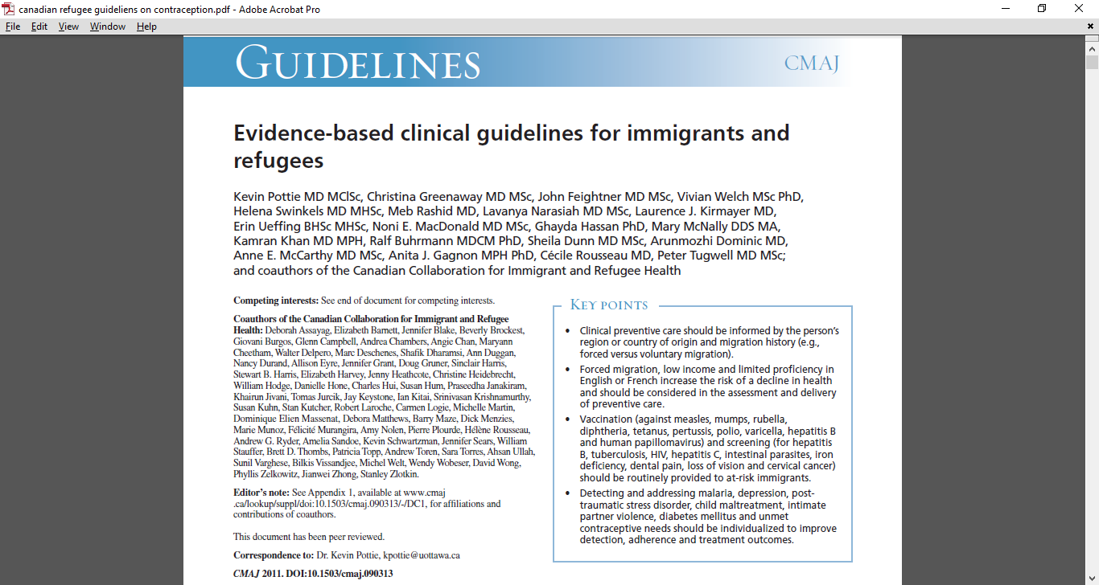
Notes:
Just when I thought I was talking about the moon, I learned form my co authors that Canada developed a whole syststm of evidence based guidelines
Target: Primary care practitioner
Encourage use of checklists and algorithms for systematic assessment
Implementation of recommendations may take 3-4 visits

Slide 21
Canadian refugee health screening guidelines
Encourage use of checklists and algorithms for systematic assessment
Implementation of recommendations may take 3-4 visits; If possible, same PCP screens and provides care for the next two years
Guidelines include testing for cervical cancer, intimate partner violence, contraceptive needs
Notes:
, a process
more akin to the delivery of well-baby care than to an annual
examination.

Slide 22
Canadian refugee health guidelines
“To prevent unintended pregnancy, screening for unmet contraceptive needs should begin soon after a woman’s arrival in Canada.”
For the complete evidence review populations, see Appendix 18, www.cmaj.ca/lookup/suppl/doi:10.1503/cmaj.090313/-/DC1
Notes:
.

Slide 23
California Refugee Health Assessment Females (2017) (5)
1.3% tested positive for chlamydia while 0.6% tested positive for syphilis.
4.8% refugee women tested positive for being pregnant at the time of the assessment.
Notes:
In California post arrival visit (2017):
total, 4.8% tested positive for being pregnant at the time of the assessment. Of the reported infectious diseases, 1.3% tested positive for chlamydia while 0.6% tested positive for syphilis.
undetected health problems like anemia and hypertension
Iraqi, Somali, and Bhutanese refugees reported delayed initiation of pre- natal care and had fewer prenatal visits compared to US-born populations
refugee populations had higher rates of Cesarean sections, stillbirths, preterm births, and lower birth weights among infants
Post-partum depression also occurred, but many women did not understand what this was, which prevented them from obtaining necessary treatment
Access and utilization of SRH care which includes family planning, maternity care, cancer or sexually transmitted disease prevention) could improve individual reproductive health autonomy, prevent unintended pregnancy, reduce abortion, and improve women long-term physical and mental wellbeing

Slide 24
Refugee screening and primary care
Refugee health assessment not designed to provide clinical preventive screening; referral to primary care
Unclear whether primary care provider (PCP) is familiar with refugee screening guidelines
Delay in accessing primary care: Medicaid enrollment, time to first appointment
Additional delays: Preference for female provider; PCP not providing women’s health services; other priorities at resettlement

Slide 25
Integration of refugee assessment in primary care
Sacramento County Department of Health reorganization 2019
All primary care clients get a full assessment, regardless the reason of visit.
Federal refugee assessment is complemented with obstetric and gynecological health, including contraceptive needs
Women can stay at same clinic for maternity and gynecologic care. DOH has live interpreters in multiple languages.
Have to select Medicaid plan that has contract with DOH for continuing primary care

Slide 26
Medicaid managed care plans
Follow up of new enrollees about access to contraceptive options
Family PACT – Family planning and family-planning related services
For low-income California residents who do not qualify for Medicaid or who need confidential services
Network of over 2,000 public and private Family PACT providers www.familypact.org - zipcode locator

Slide 27
Which biases did you observe in the assigned articles on contraceptive use in refugee women?
Shabaik SA, Awaida JY, Xandre P, Nelson AL Contraceptive Beliefs and Practices of American Muslim Women. J Womens Health (Larchmt). 2019 Jul;28(7):976-983. doi: 10.1089/jwh.2018.7500. Epub 2019 May 22.
https://www.ncbi.nlm.nih.gov/pubmed/31120322
Budhwani H, Anderson J, Hearld KR. Muslim Women's use of contraception in the United States. Reprod Health. 2018 Jan 5;15(1):1. doi: 10.1186/s12978-017-0439-6.
https://www.ncbi.nlm.nih.gov/pubmed/29304829

Slide 28
Contraceptive use among Afghan women: Avoid stereotypes
Preterm Birth Postpartum Contraception Study (2017-18) In-depth interviews with 35 women who had a preterm birth in San Francisco, Alameda, and Fresno countries
Case : 20 yrs, Afghanistan, Pastho-speaking, arrived 6 month pregnant in the U.S.
A family member had her baby a month before at the same hospital and got an IUD.
After talking to her, patient decided to get
the IUD as well.
Husband supportive of contraceptive and
birth spacing decision.

Slide 29
Lessons from postpartum contraception study on foreign-born mothers
Arrival advanced pregnancies (few time to do contraceptive counseling by provider)
No knowledge about contraceptive options in the US or bad experiences with certain methods
Medical condition that could not be treated in home country
Section of methods because of experience of friends and family (local and in home country)
Men may support to contraceptive use and birth spacing decision
Transportation and child care important

Slide 30
Reproductive Refugee Network (Repro-Net)
Engagement award, collaboration of University of California campuses with local refugee communities
San Diego and Sacramento
Engage in dialogue with refugee communities to investigate their preferences for reproductive health and well-woman care
Organize symposium at UCD Medical Center, Sacramento spring 2021 to develop a Research and Policy Agenda with and for refugee women

Slide 31
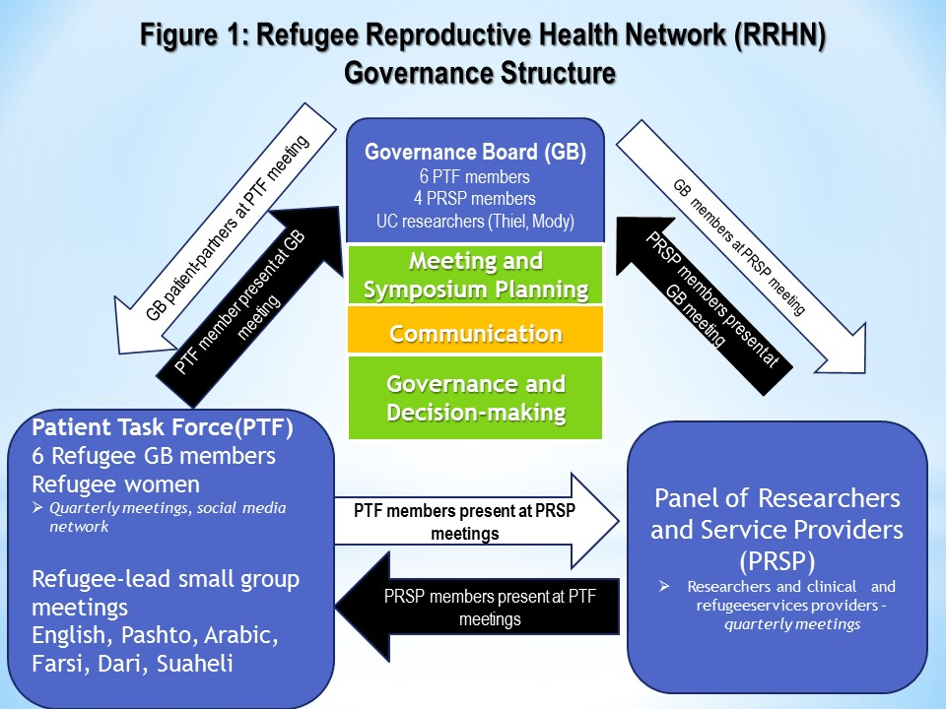

Slide 32
ReproNet collaboration with Sacramento County Department of Health - 2020
Medical chart review of contraceptive use of refugee patients
Assess pregnancy intention of refugee arrivals after health visit
COVID-19 phone survey to Afghan and Ukrainian refugees

Slide 33
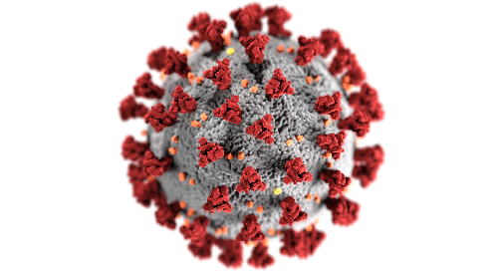
ReproNet in times of COVID-19
Change from in-person meetings to virtual meetings
Assess digital readiness of refugee communities and new opportunities (mosque services on zoom)
Change in service delivery impacts provider priorities
Internship and volunteer
opportunities: Sereen
Banna, project coordinator
sybanna@ucdavis.edu
Sign up for ReproNet provider and volunteer contact list:
https://ci-redcap.hs.uci.edu/surveys/?s=L49TD9F9E8

Slide 34
Questions and Answers
Contact:
Heike Thiel de Bocanegra, PhD, MPH
University of California, Irvine
Department of Obstetrics and Gynecology
hthiel@hs.uci.edu

Slide 35
References
Anon. Health in Afghanistan: hope and future. Lancet. 2011;378(9808):1975.
California Refugee Arrivals Data. California Department of Public Health. http://www.cdss.ca.gov/inforesources/Refugees/Reports-and-Data/Arrivals-Data
California Department Of Public Health, Office of Refugee Health. Report on refugee health in California, Federal Fiscal Year 2017. 2017.
Population Reference Bureau, international data, Afghanistan, 2018. https://www.prb.org/international/geography/afghanistan
Pottie K. Canadian refugee screening guidelines. Contraceptive section: www.cmaj.ca/lookup/suppl/doi:10.1503/cmaj.090313/-/DC1
Refugee Processing Center. Admissions and Arrivals. U.S. Department of State http://www.wrapsnet.org/admissions-and-arrivals/.
Shirazi, M., Bloom, J., Shirazi, A., & Popal, R. (2013). Afghan immigrant women's knowledge and behaviors around breast cancer screening. Psycho-Oncology, 22(8), 1705-1717.
Thiel de Bocanegra H, Carter-Pokras O, Ingleby JD, Pottie K, Tchangalova N, Allen SI, Smith-Gagen J, Hidalgo B. Addressing refugee health through evidence-based policies: a case study. Annals of Epidemiology 28 (2018) 411-419
Thiel de Bocanegra H, Kenny J, Sayler K, Turocy M, Ladella S. Experiences with Prenatal and Postpartum Contraceptive Services among Women with a Preterm Birth. Womens Health Issues. 2019 Dec 16.
Van Egmond K, Naeem AJ, Verstraelen H, et al. Reproductive health in Afghanistan: results of a knowledge, attitudes and practices survey among Afghan women in Kabul. Disasters. 2004;28(3):269-282
World Health Organization, Global Health Observatory county vies, Afghanistan statistics summary (2002-present).http://apps.who.int/gho/data/node.country.country-AFG?lang=en

Slide 36
 | Stage | Health threats
1 | Pre-conflict | Depend on the country in question, as well as on socioeconomic status, age, sex, etc. WIDE VARIATIONS both within and between countries
2 | Conflict | Physical violence (including torture); deprivation of physical, mental and social needs; separation, loss, traumatic events
3 | Flight | Immigration policies of destination countries increasingly expose would-be asylum seekers to severe threats, including exploitation, violence and death by drowning, hunger or thirst
4 | Shelter | Can be in neighboring region or high-income country, pending legal assessment. Risk of poor conditions, prolonged inactivity
5 | Resettlement | Poor access to health services, unfavorable position in society, discrimination and marginalization. Difficulties in attaining economic self-sufficiency
Notes:
So if we look at the stages of the transition from the native country to the recieing country, we usually focus on the second row, the confviolence originated in the conflict (war, torture) but refugees may have already had precarious access to health care prior to any conflict
They may have been exposed to threats , exploitation, violence during the transition for example
But may also be suffering discrimination, barriers to care

