Slide 1
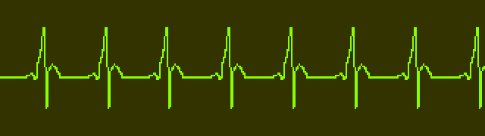
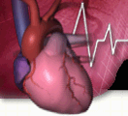

DEVELOPING CARDIOVASULAR SCREENING MEASURES FOR PREGNANT & POSTPARTUM WOMEN
Project Overview
Principal Investigator: Afshan Hameed, MD, FACOG
UCI Co-Investigators: Heike Thiel de Bocanegra, PhD, MPH
Brian Crosland, MD
UCSD Co-Investigator: Maryam Tarsa, MD, MAS
UTenn Co-Investigator: Cornelia Graves, MD

Slide 2
Problem 1
Cardiovascular disease (CVD) among pregnant and postpartum women is the leading cause of maternal mortality in the US
There are large racial/ethnic disparities in CVD-associated maternal morbidity and mortality
Normal pregnancy may mimic CVD symptoms and diagnosis may be missed
Need to standardize evaluation and triage of pregnant patients with potential CVD signs and symptoms, use of a standardized clinical decision making tool for women receiving prenatal and postpartum care
Notes:
We propose to improve detection of cardiovascular disease (CVD) among pregnant and postpartum women, the leading cause of maternal mortality in the US. There is a need to standardize evaluation and triage of pregnant patients with potential CVD signs and symptoms. Diagnosis is challenging as normal pregnancy may mimic CVD. Mortality reviews indicate that the majority (88%) of these women had preexisting risk factors for CVD and had presented more than once to their health care providers with signs and symptoms suggestive of CVD during pregnancy African-American women exhibit three-to-four-fold higher pregnancy related mortality rate,
CVD is defined as: abnormal cardiac structure and/or function demonstrated by echocardiogram or other imaging studies (systolic dysfunction, diastolic dysfunction, chamber/septal hypertrophy or dilation, pulmonary hypertension, valvular disease), or an arrhythmia

Slide 3


CA-PAMR Findings
Preventability
2002-2006
  24% of ALL CVD pregnancy-related deaths (and 31% of cardiomyopathy deaths) were determined to be potentially preventable
A CMQCC pregnancy-related mortality task force applied this algorithm to the 64 CVD deaths from 2002-2006, and determined that 56 out of 64 (88%) cases would have identified as screen-positive or high risk for CVD
Hameed AB, Foster E, Main EK, Khandelwal A, Lawton ES. Cardiovascular Disease Assessment in Pregnant and Postpartum Women | California Maternal Quality Care Collaborative. Cardiovascular Disease in Pregnancy Toolkit. https://www.cmqcc.org/resource/cardiovascular-disease-assessment-pregnant-and-postpartum-women. Published November 2017. Accessed June 14, 2019.
Hameed A, Lawton E, McCain CL, et al. Pregnancy-Related Cardiovascular Deaths in California: Beyond Peripartum Cardiomyopathy. American Journal of Obstetrics and Gynecology 2015; DOI: 10.1016/j.ajog.2015.05.008
Notes:
TALKING POINTS, Updated 9/27/17
The Committee assessed preventability as the chance to alter the fatal outcome, categorized as 1) strong; 2) good; 3) some; or 4) none. The case was considered preventable when specific and feasible actions, if implemented, might have changed the course of the woman’s trajectory and resulted in a non-fatal outcome. This determination was made by consensus
the CA-PAMR Committee determined that there was a good-to-strong chance to alter the outcome in 23.8% of the cardiovascular deaths.
Overall, 41% of all of the pregnancy-related deaths had a good-to-strong chance of preventability.
Data Source: CA PAMR, Pregnancy-Related Deaths; 2002-2006 (N=257).
Hameed A, Lawton E, McCain CL, et al. Pregnancy-Related Cardiovascular Deaths in California: Beyond Peripartum Cardiomyopathy. American Journal of Obstetrics and Gynecology 2015; DOI: 10.1016/j.ajog.2015.05.008

Slide 4
CVD Toolkit Goals
Given that CVD is the leading cause of maternal mortality & morbidity in California, the Toolkit aims to:
Encourage obstetric and other healthcare providers to retain a high index of suspicion for CVD, particularly among women with risk factors who present with symptoms in late pregnancy or early postpartum period
To serve as resource for generalists who provide maternity care to women, with special emphasis on
  Prenatal visits
  Postpartum encounters
  Emergency room visits
Hameed, AB, Morton, CH and A Moore. Improving Health Care Response to Cardiovascular Disease in Pregnancy and Postpartum Developed under contract #11-10006 with the California Department of Public Health, Maternal, Child and Adolescent Health Division. Published by the California Department of Public Health, 2017.
Notes:
TALKING POINTS, Updated 8/16/17
No additional talking points

Slide 5
Solution 1
Improve detection of CVD and CVD risk in pregnant and postpartum women with CVD Screening Toolkit Algorithm implementation.
This CVD Screening Algorithm was developed by the California Maternal Quality Care Collaborative (CMQCC) and is supported by ACOG and inclusion in the CVD bundle by the Alliance for Innovation for Maternal Health
System wide implementation of algorithm to monitor the quality of CVD Screening (universal screening, follow-up screen positive)
Notes:
We propose to improve detection of cardiovascular disease (CVD) among pregnant and postpartum women, the leading cause of maternal mortality in the US. There is a need to standardize evaluation and triage of pregnant patients with potential CVD signs and symptoms. Diagnosis is challenging as normal pregnancy may mimic CVD. Mortality reviews indicate that the majority (88%) of these women had preexisting risk factors for CVD and had presented more than once to their health care providers with signs and symptoms suggestive of CVD during pregnancy African-American women exhibit three-to-four-fold higher pregnancy related mortality rate,
CVD is defined as: abnormal cardiac structure and/or function demonstrated by echocardiogram or other imaging studies (systolic dysfunction, diastolic dysfunction, chamber/septal hypertrophy or dilation, pulmonary hypertension, valvular disease), or an arrhythmia

Slide 6
Solution 1 (cont.)
The screening tool was pilot tested at a sample of hospital departments at UCI, California, and Montefiore Medical Center, New York.
The overall screen positive rate was 8% (5% in CA vs 19% in NY). The sites differed in ethnicity, i.e. African American women (2.7% in CA vs 35% in NY, p< 0.01). The true positive rate was 1.5% at both sites. CVD was confirmed in 30% with positive screens with complete follow up.
https://www.ajog.org/article/S0002-9378(19)31756-9/fulltext
Notes:
We propose to improve detection of cardiovascular disease (CVD) among pregnant and postpartum women, the leading cause of maternal mortality in the US. There is a need to standardize evaluation and triage of pregnant patients with potential CVD signs and symptoms. Diagnosis is challenging as normal pregnancy may mimic CVD. Mortality reviews indicate that the majority (88%) of these women had preexisting risk factors for CVD and had presented more than once to their health care providers with signs and symptoms suggestive of CVD during pregnancy African-American women exhibit three-to-four-fold higher pregnancy related mortality rate,
CVD is defined as: abnormal cardiac structure and/or function demonstrated by echocardiogram or other imaging studies (systolic dysfunction, diastolic dysfunction, chamber/septal hypertrophy or dilation, pulmonary hypertension, valvular disease), or an arrhythmia

Slide 7
Approach
Integrate CVD algorithm into the EMR
Clinicians receive immediate score SCREEN POSITIVE
Follow up imaging
UCI Outcome
Improved CVD screening in Pregnant and Postpartum women
Follow up laboratory test
CVD screening added to problem list
Follow up consultations
Notes:
Hospitals integrate CVD screening algorithm into EHR system by placing a dot phrase in the patient’s problem list
Clinician receives an immediate score of women who screen positive and dot phrase instructions how to follow up (labs/imaging/consults)
Follow through will be monitored through EHR outputs.
Calculate measures for two 3-month periods (April-June, July-September) for each hospital and by age, race/ethnicity, time of positive screen (pregnancy vs. postpartum)
Upload data on follow data to UCI RedCap database, housed at UCI
Elicit feedback about the feasibility to calculate the measure using EHR records and need to modify to local circumstances.
Review measures with Measures Workgroup

Slide 8
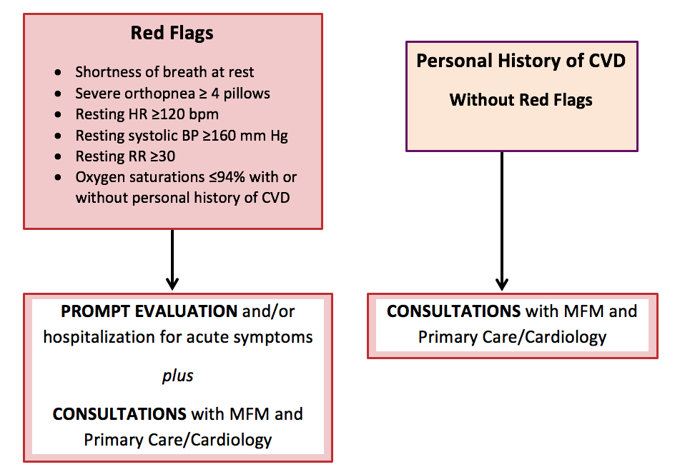
CVD Screening Algorithm Red Flags
For Pregnant and Postpartum Women
Notes:
TALKING POINTS, Updated 8/16/17
The goal of the algorithm is to assist providers in distinguishing between signs and symptoms of cardiac disease and those of normal pregnancy and to guide clinicians in the triage of further cardiac evaluation, appropriate referrals and follow-up of pregnant and postpartum women who may have cardiovascular disease. Drawing from the literature and analysis of cardiovascular deaths reviewed in the California Pregnancy-Associated Mortality Review (CA-PAMR), the authors created this algorithm based on risk factors, symptoms, vital sign abnormalities, and physical examination findings commonly identified in women who die of various types of cardiovascular disease.
The most severe symptoms and vital sign abnormalities are labeled as “Red Flags” and include shortness of breath at rest, severe orthopnea necessitating sleeping upright with 4 or more pillows, resting heart rate > 120 beats per minute, resting systolic blood pressure > 160 mm Hg, resting respiratory rate of > 30 breaths per minute and an oxygen saturation < 94%. The presence of Red Flags OR a personal history of cardiovascular disease in pregnant or postpartum women should lead clinicians to conduct a prompt evaluation and seek consultations with specialists in maternal fetal medicine, primary care, or cardiology. If other less severe symptoms and vital sign abnormalities are identified, then risk factors and physical examination findings may need to be combined to stratify the women who require further work-up or routine follow-up.

Slide 9
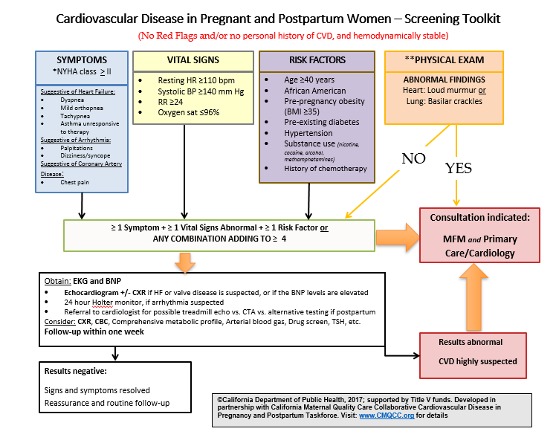
CVD Screening Algorithm
For Pregnant and Postpartum Women
Notes:
TALKING POINTS, Updated 8/16/17
The goal of the algorithm is to assist providers in distinguishing between signs and symptoms of cardiac disease and those of normal pregnancy and to guide clinicians in the triage of further cardiac evaluation, appropriate referrals and follow-up of pregnant and postpartum women who may have cardiovascular disease. Drawing from the literature and analysis of cardiovascular deaths reviewed in the California Pregnancy-Associated Mortality Review (CA-PAMR), the authors created this algorithm based on risk factors, symptoms, vital sign abnormalities, and physical examination findings commonly identified in women who die of various types of cardiovascular disease.
The most severe symptoms and vital sign abnormalities are labeled as “Red Flags” and include shortness of breath at rest, severe orthopnea necessitating sleeping upright with 4 or more pillows, resting heart rate > 120 beats per minute, resting systolic blood pressure > 160 mm Hg, resting respiratory rate of > 30 breaths per minute and an oxygen saturation < 94%. The presence of Red Flags OR a personal history of cardiovascular disease in pregnant or postpartum women should lead clinicians to conduct a prompt evaluation and seek consultations with specialists in maternal fetal medicine, primary care, or cardiology. If other less severe symptoms and vital sign abnormalities are identified, then risk factors and physical examination findings may need to be combined to stratify the women who require further work-up or routine follow-up.

Slide 10
Population screened by the algorithm
All new pregnant and postpartum patients at a prenatal or postpartum visit
Return patients who have not been screened before
Any patient new/previously screened who has new cardiac symptoms
The algorithm should only be applied once per patient unless they have new cardiac symptoms
Exclude:
  Any women with known history of cardiac disease
  Women who have another reason to visit clinic (not prenatal or postpartum care) and have a positive pregnancy test but plan to terminate pregnancy or seek prenatal services elsewhere

Slide 11
Developing CVD Measures for Pregnant and Postpartum Women
Problem 2
Solution 2
Currently, there is a lack of HEDIS indicator for pregnant/postpartum women that monitors or mandates CVD detection and/or CVD risk screening using a validated tool. Current HEDIS indicators target patients who were already identified with hypertensive disorders and/or had a heart attack to improve management of the disease and prevent further complications
Develop measures to measure hospital and clinician performance using the CVD screening algorithm results

Slide 12
Aims
To demonstrate the feasibility to calculate meaningful and actionable measures using data from the hospital wide network
To explore whether the system wide administration of the measure will produce a similar yield to that of the pilot studies
To investigate the global cardiovascular risk assessment in all pregnant women at their first encounter with an obstetrics provider
To assess the percentage of pregnant and postpartum women at maternity facilities who are screened and, if positive, followed-up for CVD risk modification.

Slide 13
Proposed Measures
Pregnant + postpartum women screened for CVD using algorithm
______________________________________________________
All pregnant + postpartum women seen at facility
1. CVD Risk Assessment =
Women who received follow up for CVD risk
_____________________________________
Women who screened positive for CVD risk
2. CVD Risk Follow-up =
Notes:
Two proposed measures:
1. CVD screening: The percentage of all pregnant and postpartum women (denominator) who underwent systematic screening for CVD using a standardized tool (numerator)
2. Follow-up to women who screened positive: The percentage of members who screened positive for CVD risk (denominator) and received follow-up care within two months of a positive screening (numerator).
Denominator ; Women (a) who have their first office visit for prenatal or post-partum care at the intervention sites (regardless of gestational age or prior prenatal care at other sites) or (b) who present with moderate symptoms during any prenatal or postpartum encounter. Exclusion criteria: Women with prior history of known cardiac disease.
Numerator: Women who screen positive for CVD risk: Have >1 Symptoms + >1 vital sign+ >1 Risk factors or ANY COMBINATION ADDING TO >4 (see figure 1)
Measure 2: Follow up of women who screen positive and determination of CVD:
Denominator: Women who screen positive for CVD risk
Numerator: Women receiving follow up
- Women with a positive screen will be referred to receive an ECG and BNP
- Abnormal ECG/BNP (ECG or BNP> 100) will be followed up with subsequent cardiac studies (ie echocardiogram, Holter or cardiology assessment).

Slide 14
Activities
The CVD Toolkit Algorithm is implemented at three hospital systems who will serve in a six-month period and include 7,500-10,000 unique pregnant and postpartum women.
Hospitals will have a diverse demographic and geographic mix, serving a large proportion of low-income women and women with complex pregnancies and being located in urban and rural communities in two states (California and Tennessee).
De-identified data on screening results and follow up will be uploaded monthly for six months to a secure database housed in the UCI academic research environment.

Slide 15
Activities (cont.)
The measures will be calculated for two 3-month periods for each hospital and by age, race/ethnicity, and time of positive screen (pregnancy vs. postpartum) to estimate internal consistency of the measure.
We use ICD-10 and CPT codes to track the different groups of women and use the number of unique women in these groups to calculate the measures.
These codes will also be used to conduct a cost analysis to compare between the CVD risk assessment group with their additional follow-ups to the group of women who do not receive screening for CVD risk.
We will elicit feedback from clinic administrators, IT services and clinicians about the feasibility to calculate the measure using EMR records and need to modify to local circumstances.

Slide 16
Technical Expert Panel (TEP)
The Technical Expert Panel is made up of a diverse groups of content experts such as: performance measurement, clinical content (cardiology/maternal fetal medicine), clinical informatics, and patient representative
The purpose of the TEP is to foster inclusion of diverse perspectives from stakeholders who will be affected by the measures.
The TEP promotes transparency in the measure development process and feedback is used to develop the measures appropriately.

Slide 17
Study Sites and Investigators
University of California, Irvine, Medical Center Health Systems
UCI Health 1,500 births a year, 3% black
Afshan Hameed, MD/Heike Thiel de Bocanegra, PhD/Brian Crosland, MD
University of California, San Diego, Medical Center Health Systems
UCSD Jacobs & Hillcrest 3,000 births a year, 5-6% black
Maryam Tarsa, MD
University of Tennessee, St Thomas Health Systems
St Thomas Health Systems 12,000 deliveries in 2018, 25% black
Cornelia Graves, MD

