Slide 1
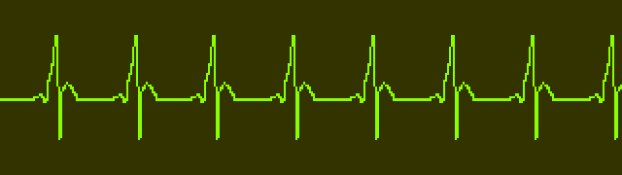
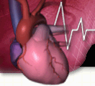

Cardiovascular Disease Screening Algorithm for Pregnant and Postpartum Women

Slide 2
Cardiovascular Disease (CVD) Toolkit
The California Maternal Quality Care Collaborative (CMQCC), a multi-stakeholder organization committed to ending preventable morbidity, mortality and racial disparities in California maternity care developed a CVD screening toolkit for prenatal care and to other providers who encounter obstetric patients
The acceptability of the tool is further strengthened by the support it has received by ACOG, and its inclusion in the CVD bundle by the Alliance for Innovation for Maternal Health
The toolkit aims to encourage obstetric and other healthcare providers to retain a high index of suspicion for CVD, particularly among women with risk factors who present with symptoms in late pregnancy or early postpartum period

Slide 3
CVD Screening Algorithm
The CMQCC cardiovascular toolkit includes a CVD screening algorithm which guides stratification and initial evaluation of symptomatic or high-risk pregnant or postpartum women
The algorithm risk stratifies patients using 18 parameters including patient’s history, abnormal symptoms, vital signs and physical examination findings to identify women who warrant further cardiac work-up
The algorithm contains a red flags list, which indicates immediate follow-up evaluation and consultation

Slide 4
CVD Screening Algorithm
A patient is screen positive if ≥ 1 Symptom + ≥ 1 Vital Signs Abnormal + ≥1 Risk Factor or Any Combination ≥4
Positive screenings are suggested for follow-ups, such as:
  Obtain: EKG and BNP
    Echocardiogram +/- CXR if HF or valve disease is suspected, or if the BNP levels are elevated
    24 hour Holter monitor, if arrhythmia suspected
    Referral to cardiologist for possible treadmill echo vs. CTA vs. alternative testing if postpartum
  Consider: CXR, CBC, Comprehensive metabolic profile, Arterial blood gas, Drug screen, TSH, etc.

Slide 5


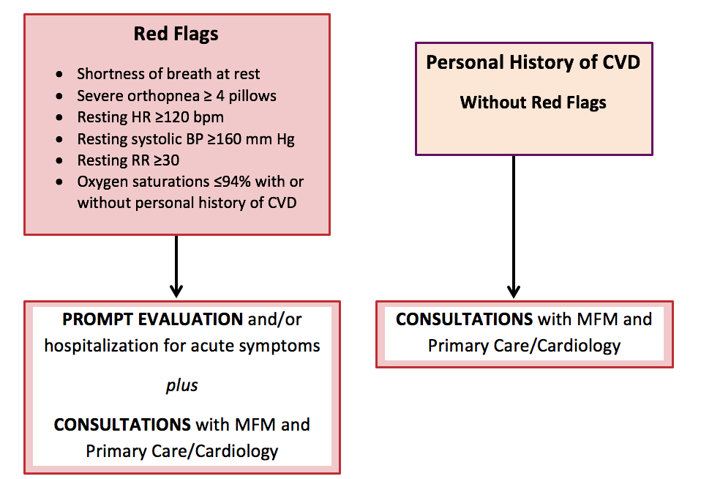
CVD Screening Algorithm Red Flags
For Pregnant and Postpartum Women
Notes:
TALKING POINTS, Updated 8/16/17
The goal of the algorithm is to assist providers in distinguishing between signs and symptoms of cardiac disease and those of normal pregnancy and to guide clinicians in the triage of further cardiac evaluation, appropriate referrals and follow-up of pregnant and postpartum women who may have cardiovascular disease. Drawing from the literature and analysis of cardiovascular deaths reviewed in the California Pregnancy-Associated Mortality Review (CA-PAMR), the authors created this algorithm based on risk factors, symptoms, vital sign abnormalities, and physical examination findings commonly identified in women who die of various types of cardiovascular disease.
The most severe symptoms and vital sign abnormalities are labeled as “Red Flags” and include shortness of breath at rest, severe orthopnea necessitating sleeping upright with 4 or more pillows, resting heart rate > 120 beats per minute, resting systolic blood pressure > 160 mm Hg, resting respiratory rate of > 30 breaths per minute and an oxygen saturation < 94%. The presence of Red Flags OR a personal history of cardiovascular disease in pregnant or postpartum women should lead clinicians to conduct a prompt evaluation and seek consultations with specialists in maternal fetal medicine, primary care, or cardiology. If other less severe symptoms and vital sign abnormalities are identified, then risk factors and physical examination findings may need to be combined to stratify the women who require further work-up or routine follow-up.

Slide 6
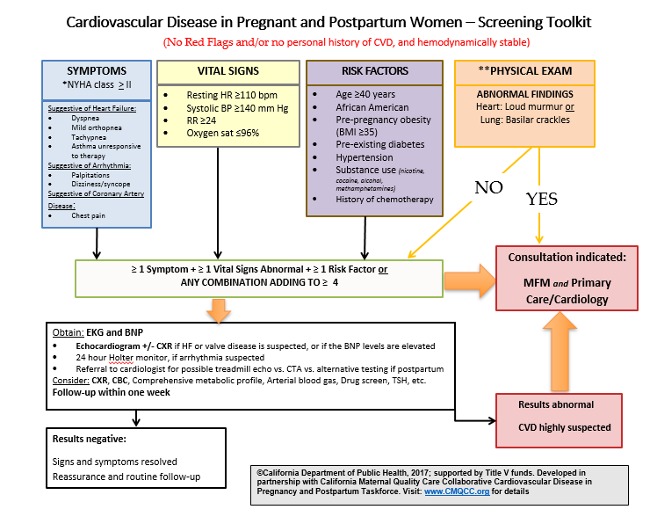
CVD Screening Algorithm
For Pregnant and Postpartum Women
Notes:
TALKING POINTS, Updated 8/16/17
The goal of the algorithm is to assist providers in distinguishing between signs and symptoms of cardiac disease and those of normal pregnancy and to guide clinicians in the triage of further cardiac evaluation, appropriate referrals and follow-up of pregnant and postpartum women who may have cardiovascular disease. Drawing from the literature and analysis of cardiovascular deaths reviewed in the California Pregnancy-Associated Mortality Review (CA-PAMR), the authors created this algorithm based on risk factors, symptoms, vital sign abnormalities, and physical examination findings commonly identified in women who die of various types of cardiovascular disease.
The most severe symptoms and vital sign abnormalities are labeled as “Red Flags” and include shortness of breath at rest, severe orthopnea necessitating sleeping upright with 4 or more pillows, resting heart rate > 120 beats per minute, resting systolic blood pressure > 160 mm Hg, resting respiratory rate of > 30 breaths per minute and an oxygen saturation < 94%. The presence of Red Flags OR a personal history of cardiovascular disease in pregnant or postpartum women should lead clinicians to conduct a prompt evaluation and seek consultations with specialists in maternal fetal medicine, primary care, or cardiology. If other less severe symptoms and vital sign abnormalities are identified, then risk factors and physical examination findings may need to be combined to stratify the women who require further work-up or routine follow-up.

Slide 7
CMQCC Resource
For more information on the CMQCC Toolkit or Algorithm, visit their website: CMQCC CVD Toolkit

